Slide 1


Pangeo, an open-science non-fiction
Aparna Radhakrishnan
On behalf of the
PANGEO
https://pangeo.io/about.html
WCRP Open Science Conference 2023, Rwanda
Session: LL04 - CMIP and CORDEX Analysis and Evaluation Tools

Slide 2
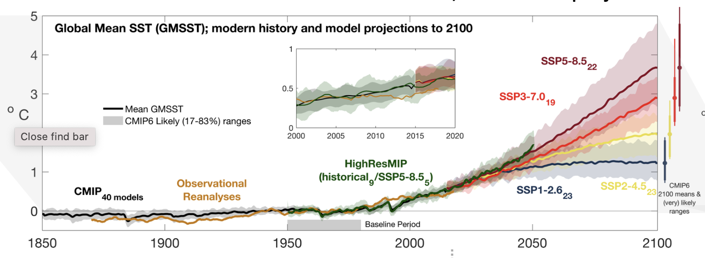
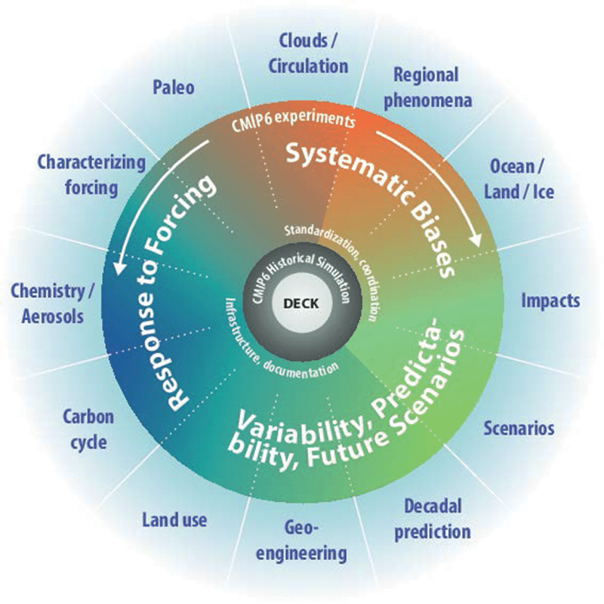
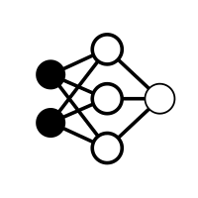

Students
Researchers
Diverse audience
Decision makers
Climate impact
Regional modeling
Many more..
Wonder if I could reproduce this figure from IPCC Chapter 9 and extend it?
Usable and scalable ways to apply compute?
I want to apply ML on CMIP models
Ease of analyzing big data
Analysis Reproducibility
Separation of Data storage and compute
Democratizing access
A.Radhakrishnan, Pangeo, WCRP OSC 2023

Slide 3

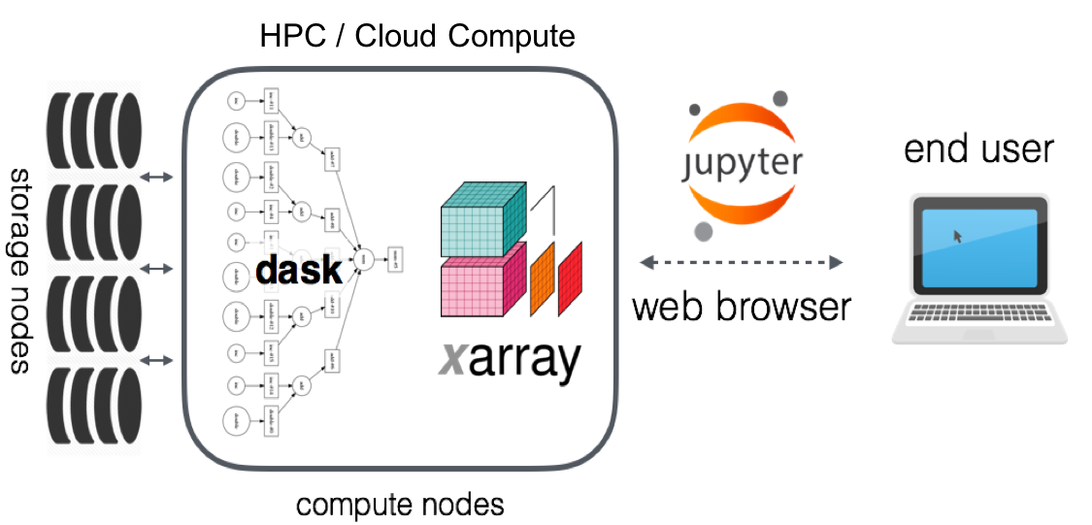
A cloud-native scientific data analytics ecosystem
A.Radhakrishnan, Pangeo, WCRP OSC 2023
Notes:
The flexibility created by "separation of storage and compute" - there can be one copy of the data and many, many different approaches to computing over it. The data provider can support data-proximate computing without actually becoming a compute provider as well

Slide 4
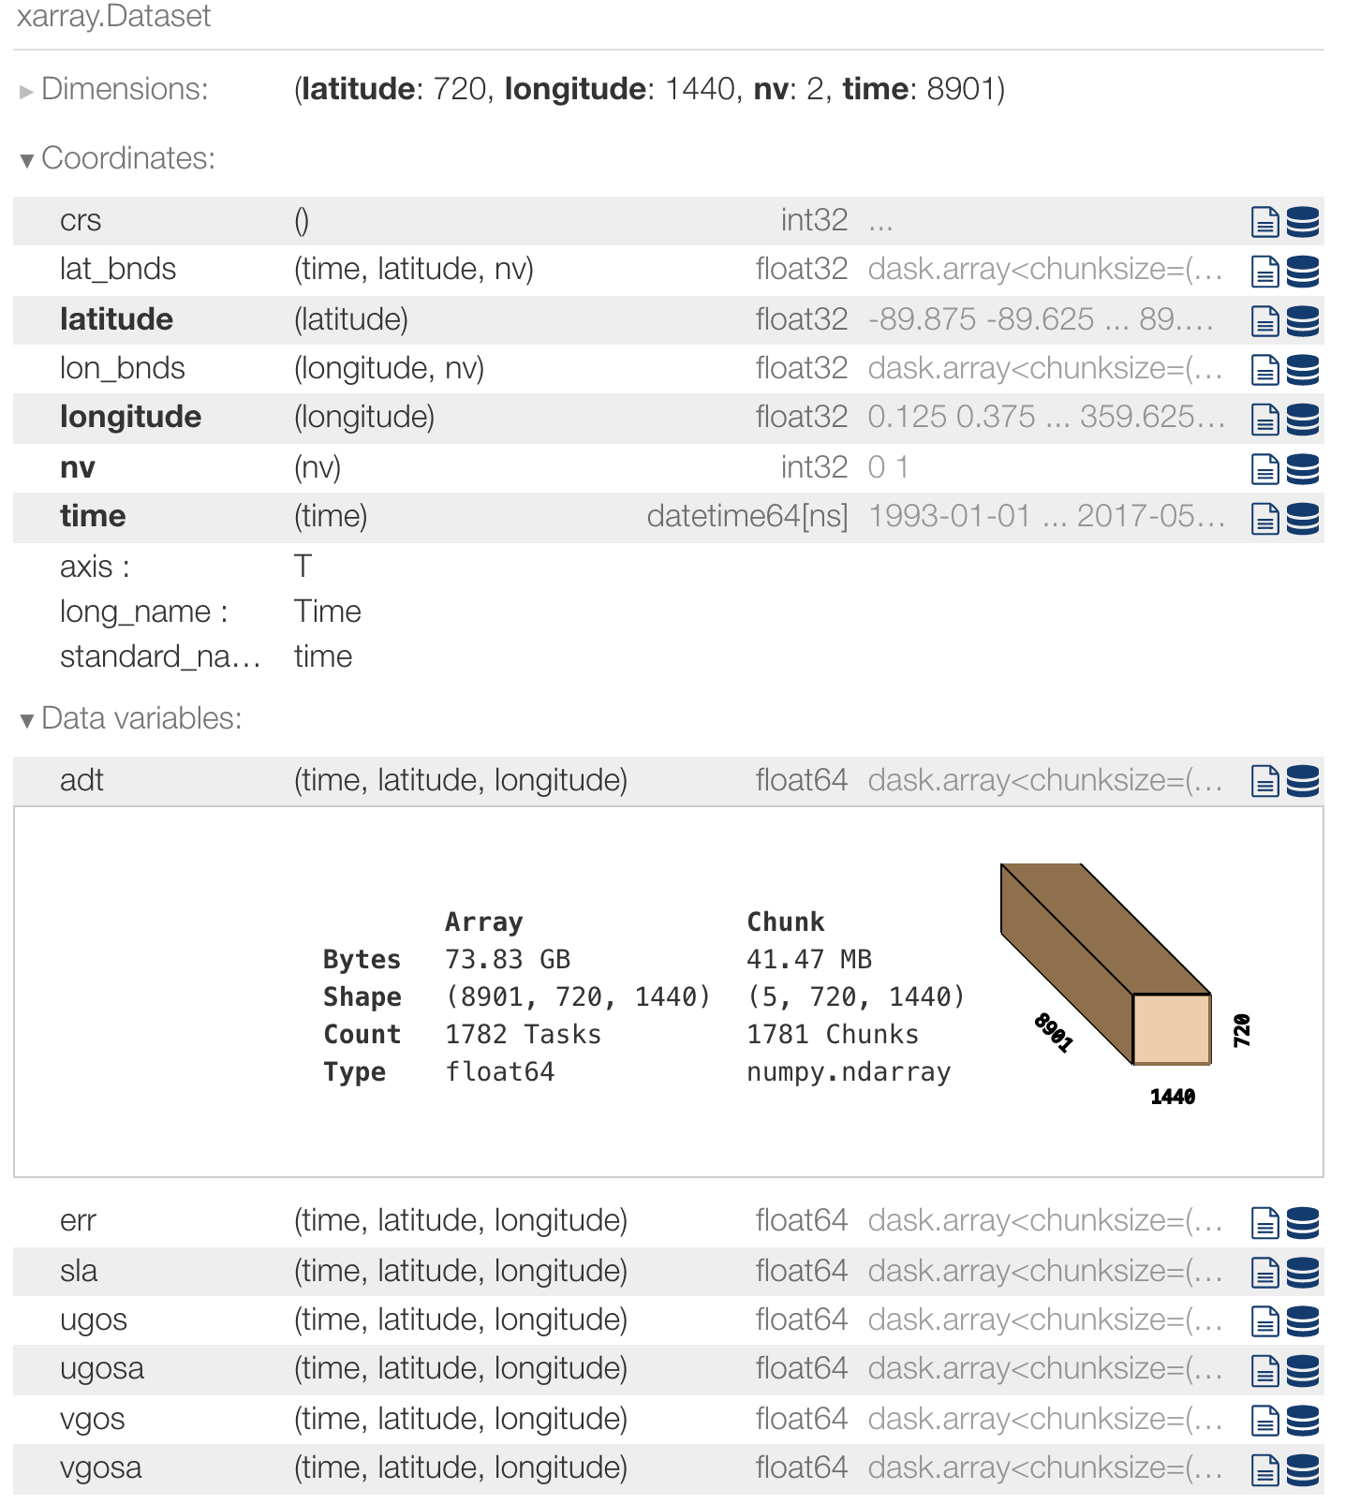
A cloud-native scientific data analytics ecosystem
Xarray
Simple gateway to exploring different data formats and input
sources.
Code it like you say it (Easy to get started!)
E.g. ds.sel(time='2000-01’)
A.Radhakrishnan, Pangeo, WCRP OSC 2023
Notes:
The flexibility created by "separation of storage and compute" - there can be one copy of the data and many, many different approaches to computing over it. The data provider can support data-proximate computing without actually becoming a compute provider as well

Slide 5



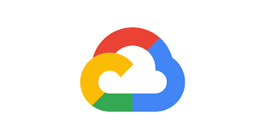


A cloud-native scientific data analytics ecosystem
(AWS) zarr https://cmip6-pds.s3.amazonaws.com/index.html#CMIP6/
(AWS netcdf) https://esgf-world.s3.amazonaws.com/index.html
(Google cloud zarr) https://console.cloud.google.com/storage/browser/cmip6
How to request for additional CMIP6 data in the cloud?
https://pangeo-data.github.io/pangeo-cmip6-cloud/requesting_data.html
Thank you Pangeo community
A.Radhakrishnan, Pangeo, WCRP OSC 2023
Notes:
The flexibility created by "separation of storage and compute" - there can be one copy of the data and many, many different approaches to computing over it. The data provider can support data-proximate computing without actually becoming a compute provider as well

Slide 6


A cloud-native scientific data analytics ecosystem
cat = intake.open_esm_datastore(url)
exp_filter = ['historical']
table_id_filter = 'Amon'
variable_id_filter = "tas"
cat = col.search(experiment_id=exp_filter,
table_id=table_id_filter,
variable_id=variable_id_filter)
Data catalogs
https://pangeo-data.github.io/pangeo-cmip6-cloud/pangeo_catalog.html
https://cmip6-nc.s3.us-east2.amazonaws.com/esgf-world.json
E.g usage and notebooks
Intake-esm
Pangeo gallery
catalog with 55 dataset(s) from 1872 asset(s):
Intake-esm
A.Radhakrishnan, Pangeo, WCRP OSC 2023
Notes:
The flexibility created by "separation of storage and compute" - there can be one copy of the data and many, many different approaches to computing over it. The data provider can support data-proximate computing without actually becoming a compute provider as well

Slide 7
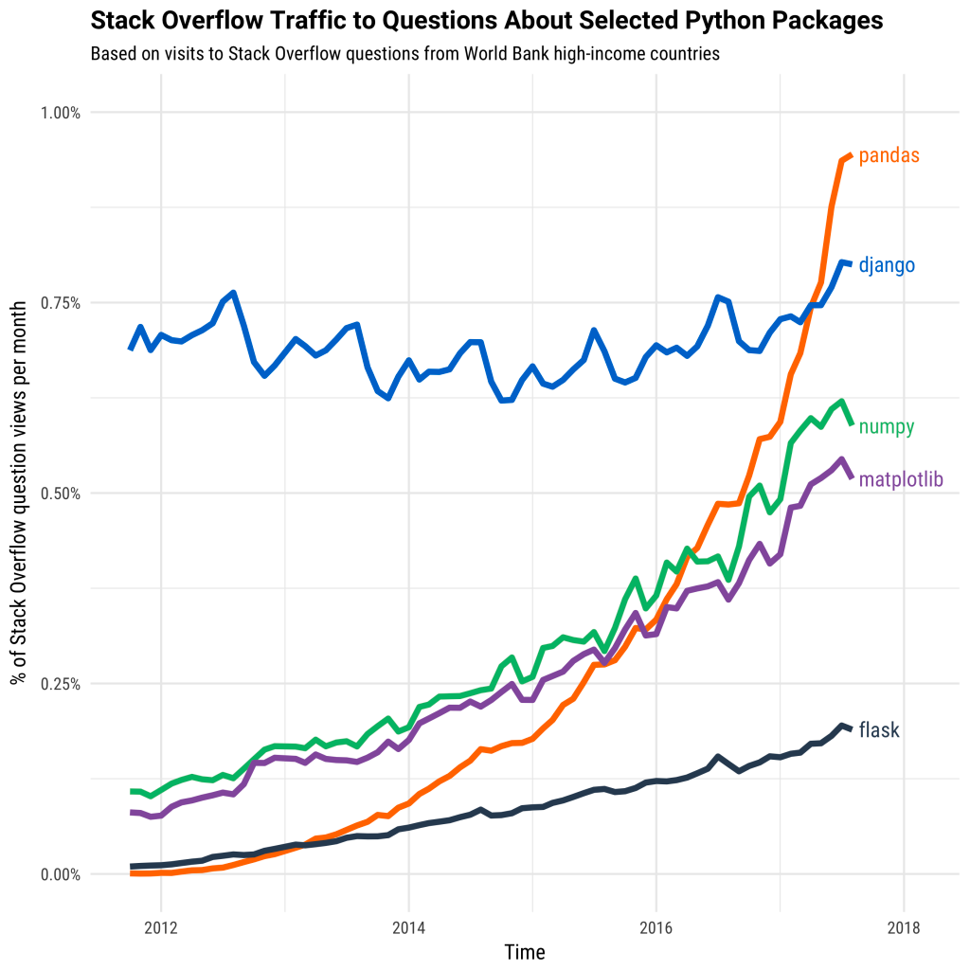
A cloud-native scientific data analytics ecosystem
Dask
Multi-DASKS: Scales up (distributed clusters) and down (single-machine scheduler)
Integrates well with python analysis packages
A.Radhakrishnan, Pangeo, WCRP OSC 2023
Notes:
The flexibility created by "separation of storage and compute" - there can be one copy of the data and many, many different approaches to computing over it. The data provider can support data-proximate computing without actually becoming a compute provider as well

Slide 8
THANK YOU
Contact us!
Open a GitHub issue https://github.com/pangeo-data/pangeo-cmip6-cloud/issues or start a discussion here: https://discourse.pangeo.io/
LEARN MORE!
[https://pangeo-forge.org/] Transform your data into an analysis-ready, cloud-optimized (ARCO) data stores
[https://pangeo-data.github.io/pangeo-cmip6-cloud/] Zarr/Netcdf in the cloud and other useful info.
[https://pangeo-data.github.io/pangeo-cmip6-cloud/pangeo_catalog.html] Data discovery and analysis
[https://github.com/jbusecke/xMIP] Using data catalogs, xarray, dask and much more for multi-model analysis
[Related recorded videos]
SPECIAL THANKS TO RYAN ABERNATHEY and JULIUS BUSECKE FOR THE CONTENT AND CONTRIBUTIONS.
Cite our work:
We acknowledge the work of the [Pangeo / ESGF Cloud Data Working Group](https://pangeo-data.github.io/pangeo-cmip6-cloud/) who manage the ingestion and hosting of the Analysis-Ready Cloud Optimized copies of CMIP6 datasets on public cloud storage hosted by Google and Amazon.
[CMIP6 recommended citation]
A.Radhakrishnan, Pangeo, WCRP OSC 2023

